Slide 1
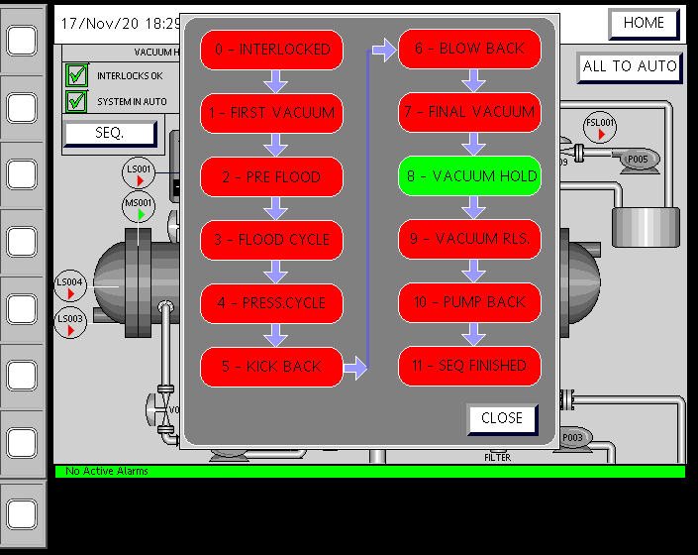
Plant Operation Sequences

Slide 2
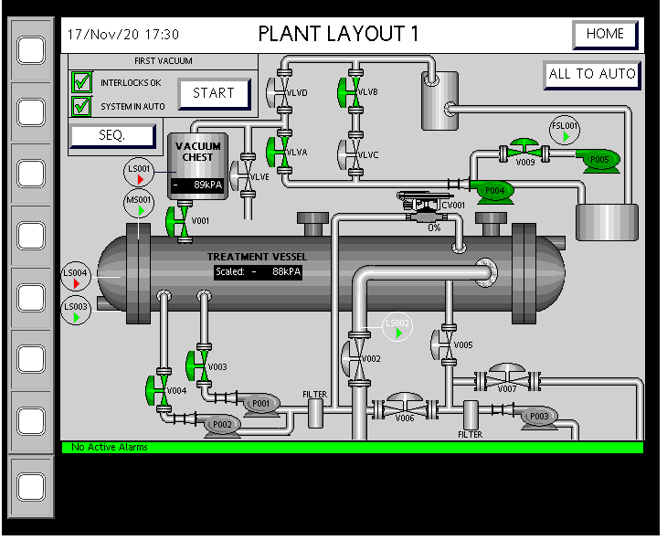
1- First Vacuum

Slide 3
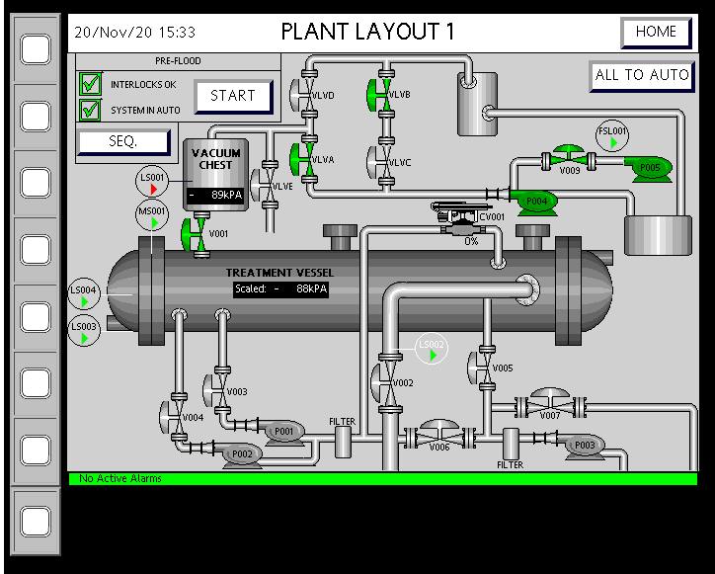
2- Pre Flood

Slide 4
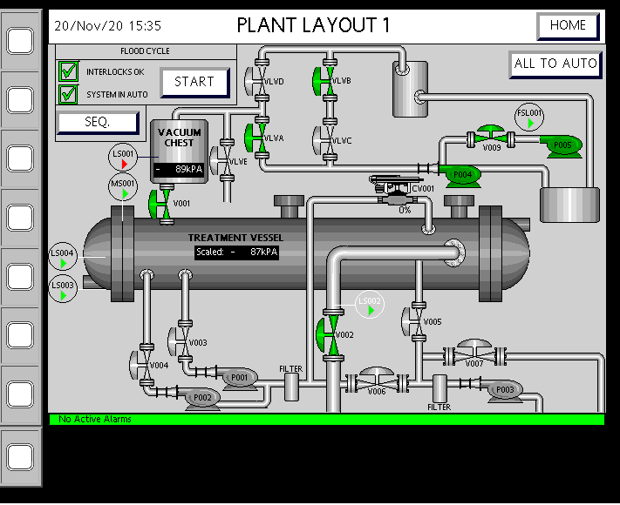
3-Flood Cycle1

Slide 5
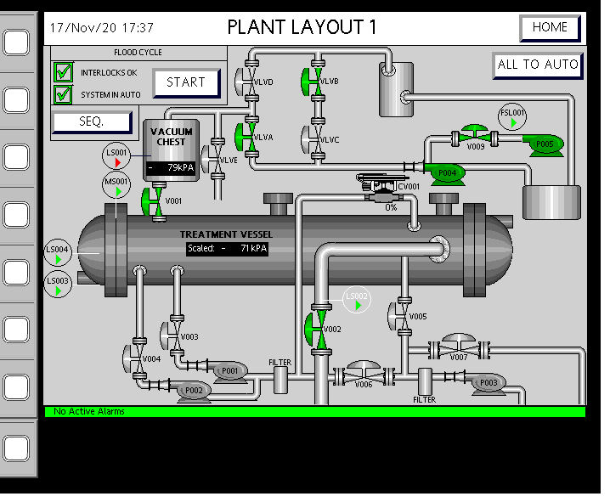
3- Flood Cycle2

Slide 6
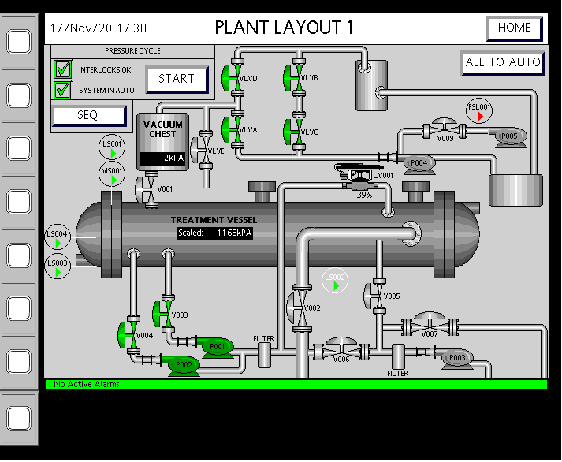
4-Pressure Cycle1

Slide 7
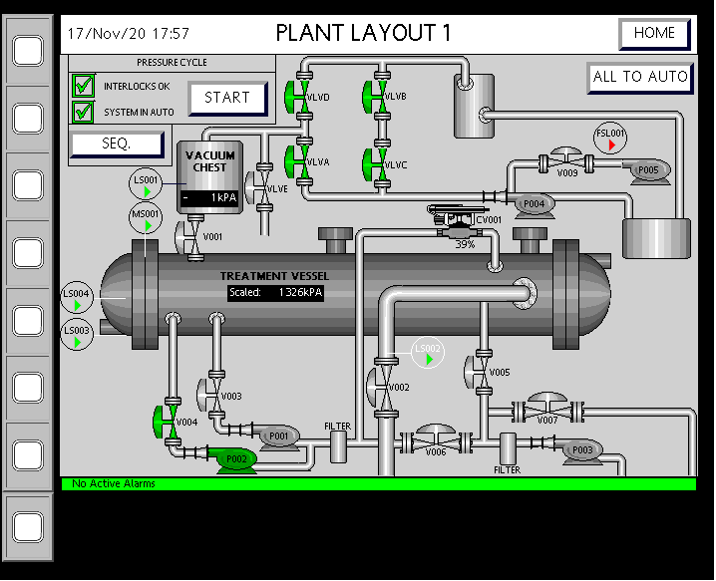
4-Pressure Cycle2

Slide 8
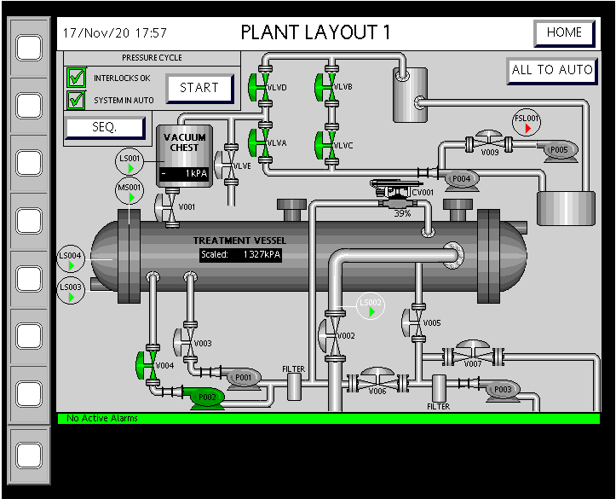
4-Pressure Cycle3

Slide 9
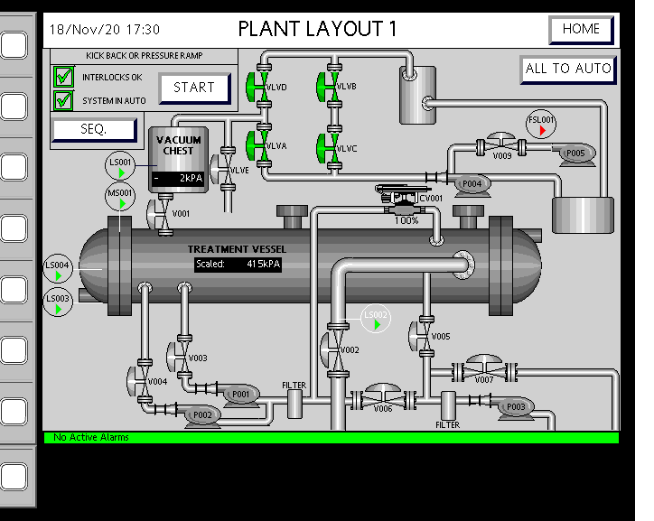
5- Kick Back

Slide 10
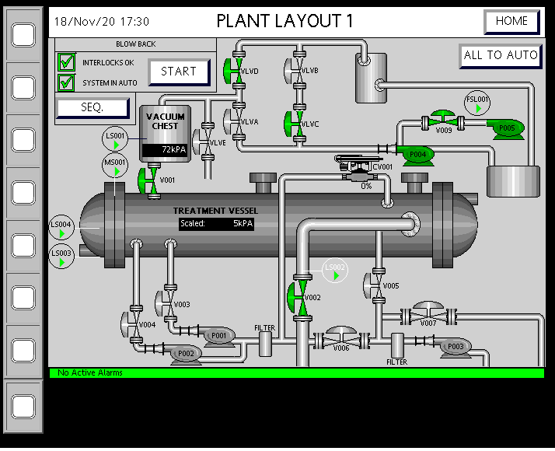
6- Blow Back1

Slide 11
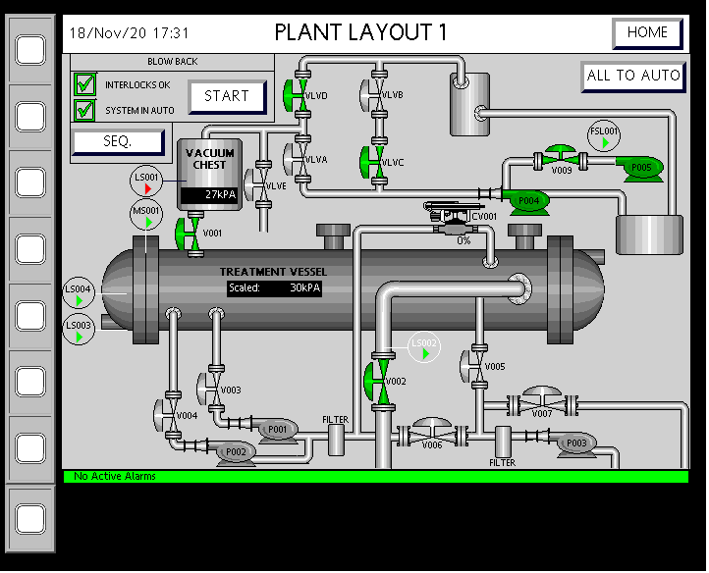
6- Blow Back2

Slide 12
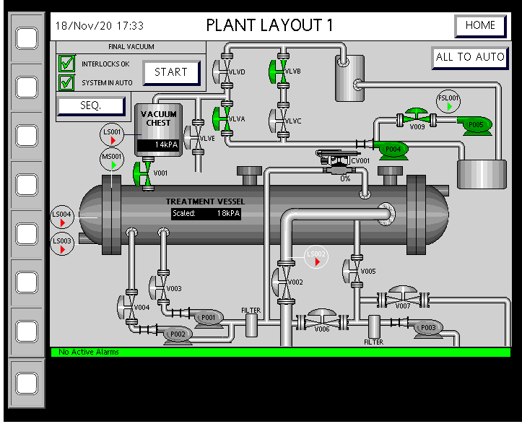
7- Final Vacuum1

Slide 13

7- Final Vacuum2

Slide 14
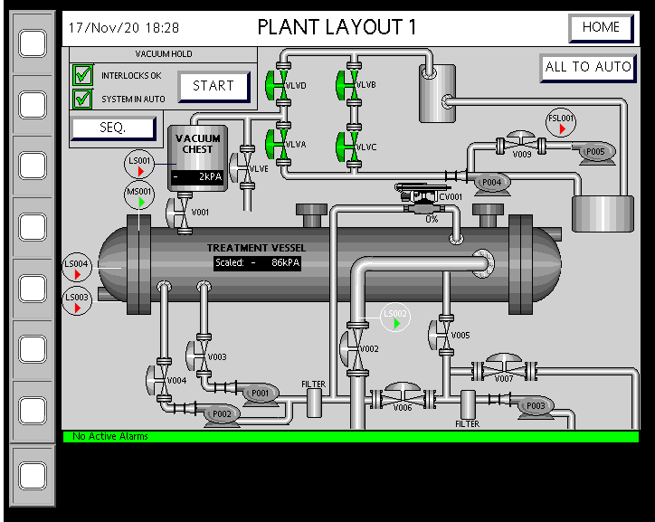
8- Vacuum Hold

Slide 15
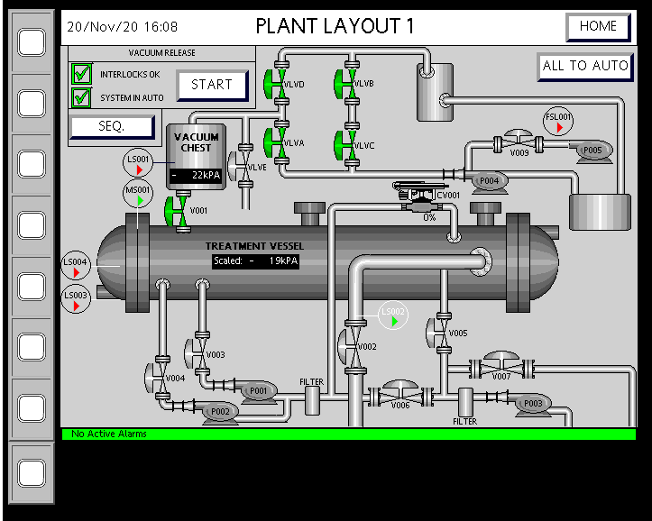
9- Vacuum Release

Slide 16
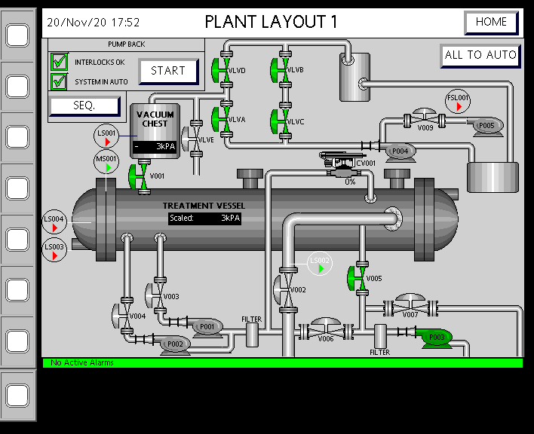
10- Pump Back

Slide 17
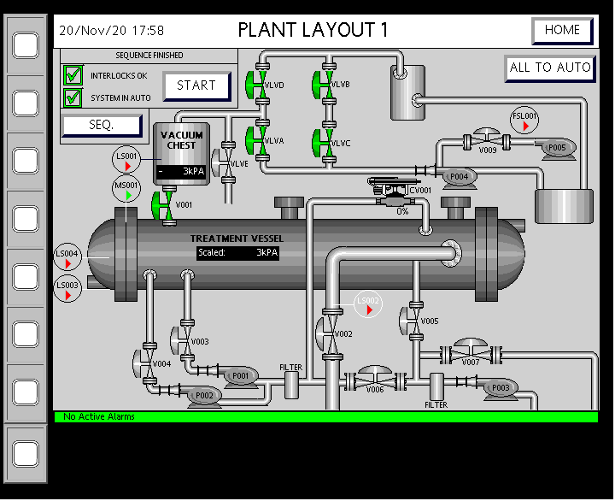
Sequence Finish

